Slide 1
The Moon
The Earth and Moon move through space in two major ways.
Rotation
Revolution

Slide 2
Rotation
The spinning of the Earth/Moon on its axis

Slide 3
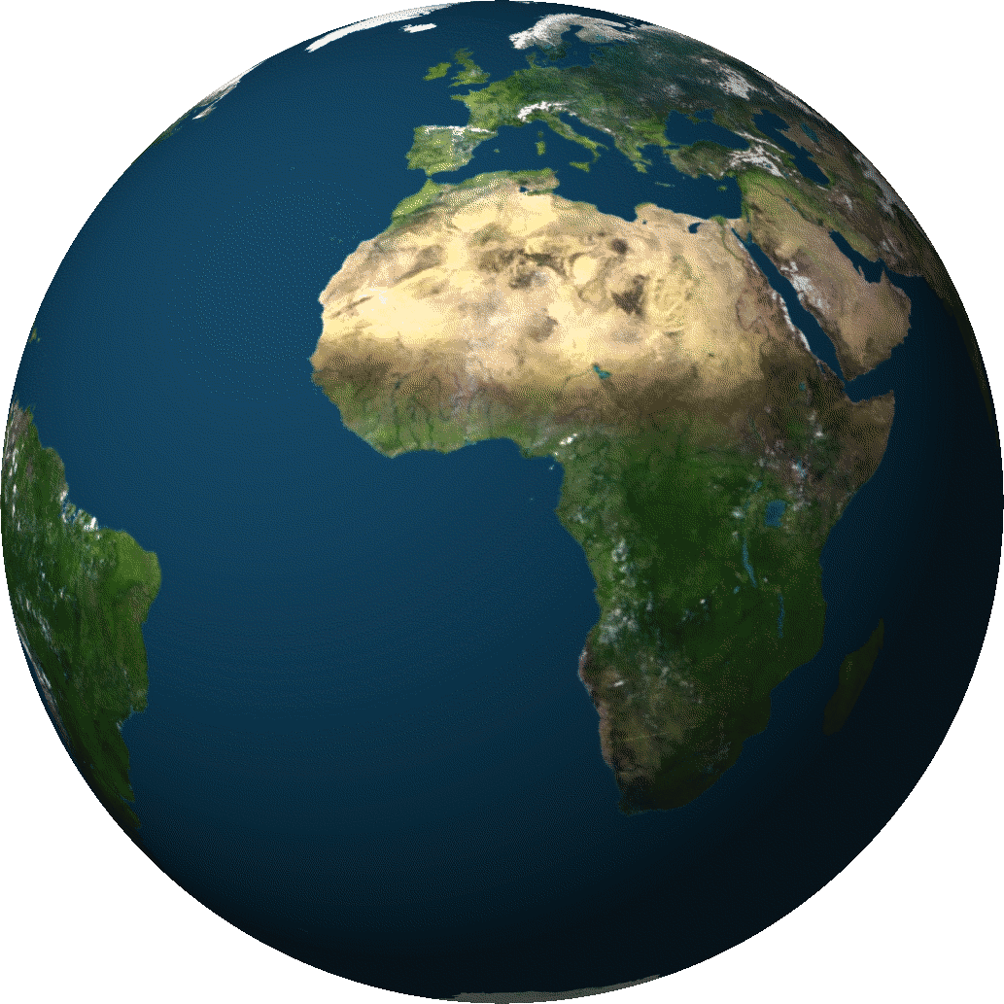
Rotation
The spinning of the Earth/Moon on its axis

Slide 4
Examples?

Slide 5
Examples

Slide 6
Rotational Time
The Earth takes approximately 24 hours to make one complete rotation.
The Moon takes approximately 27.3 days to make one complete rotation

Slide 7
Revolution
The movement of one object around another

Slide 8
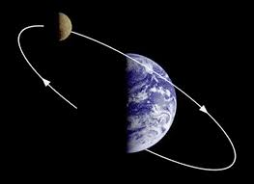
Revolution
The Moon revolves around the Earth

Slide 9
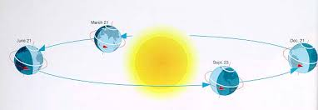
Revolution
The Earth revolves around the Sun

Slide 10
Revolution Time
The Moon takes approximately 27.3 days to revolve around the Earth.
The Earth takes approximately 365 ¼ days to revolve around the Sun

Slide 11
Both the Earth and the Sun follow a path, or orbit, as each one revolves.

Slide 12
What keeps the Moon in orbit around the Earth?
Gravity and inertia work together to keep the Moon in orbit.

Slide 13
Gravity
A non-contact force that attracts a body toward the center of the earth, or toward any other physical body having mass
In your own words-

Slide 14
Gravity
The larger the mass of the object the more gravitational force it has.
The Moon has 1/6 the gravitational force of the Earth
As distance increases between two objects the gravitational force decreases.
The farther away a celestial body (Moon, Earth, Sun) is the less gravitational attraction it has.

Slide 15
Inertia
Newton’s 1st Law- an object at rest will stay at rest, and an object in motion will stay in motion with constant speed and direction unless acted upon by an outside force.
In your on words-

Slide 16
Working together
The Earth’s gravity is pulling the Moon towards Earth
At the same time, the Moon keeps moving forward because of its inertia

Slide 17
Draw this
Orbit

Slide 19
Moon Facts
From Earth you can only see one side of the moon.
The Moon is approximately 240,000 miles from Earth.
The Moon does not have its own light source, the Moon reflects light from the Sun.
The Orbital speed of the moon is 3680 km per hour (2,287 mph).
When sunlight hits the moon's surface, the temperature can reach 253 degrees F (123 C). The "dark side of the moon" can have temperatures dipping to minus 243 F (minus 153 C).

Slide 20
Moon Facts
The earth rotates about 1000 mph. By comparison, the moon rotates about 10 mph.
The moon has no significant atmosphere or clouds.
The word "lunatic" comes from when doctors thought that the insane were "moonstruck.“
The Moon is getting farther away from the Earth every year.

